Slide 1
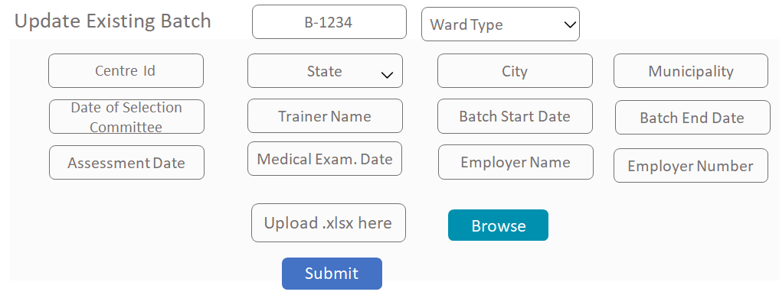

Generates the credentials and provides the targets to training partner
Logs in to the application with credentials provided by SCGJ
1
Training Partner generates new batch
2
SCGJ Admin
Training Partner
3
Data gets submitted into the system (Information can be updated multiple times)
Update the canter information
5
Master Sheet gets downloaded
Generate New Batch
8
4
Training Partner Fills the excel sheets
Excel sheet is uploaded in the system
(Can be uploaded multiple times (data
Should be updated)
6
7
Selects the Batch Id and enters the center details and
clicks on submit button
Excel Sheet containing information of candidates and batches

Slide 2

Navigates to the Generate Final Batch report page
Training Partner
User enters the Batch Id and SCGJ Batch Number
Uploads 2 images for each day total of 14 images
Clicks on Generate Report Button
Report Generated and downloaded

Slide 3
Visits → https://www.scgjsksd.in
User
Enters the Username and Password
SCGJ Home Page
Login
SCGJ
Role ?
Authentic User ?
TP Home Page
Training Partner
Yes
No
“Invalid Username or Password”

Slide 4
Search Generated Credentials
Navigates to Generate Credentials Page
SCGJ Admin
Enters all the details required to generate the credentials
Generate Credentials
Success
Details of Generated Credentials
Yes
No
Success
Yes
Already Exists
Training Partner Already Exists
No Data Found
Credentials successfully generated
No
Credentials could not be created

Slide 5
Navigates to the Generate Reports Page
Training Partner
Clicks on the drop down containing different options
Selects the report to be generated & Enters the Batch Id
Report Generated and Downloaded
Yes
Occupation Certificate
Data Present?
Clicks on Generate Reports Button
“Report is not ready”
No
Generate Report

Slide 6
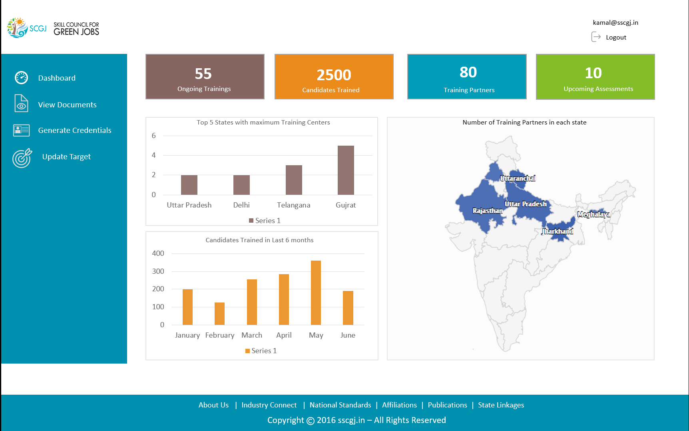
Lands on the dashboard screen
SCGJ Admin
Monitoring of important statistics and information

Slide 7
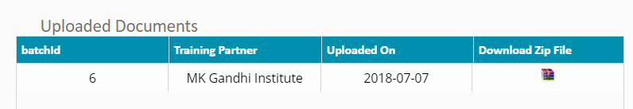

Lands on the view documents page
SCGJ Admin
Enters the Name of Training Partner and Batch Id or SCGJ Batch Number
Search
Doc.
Present ?
Yes
No
“ It looks like training partner has not uploaded documents for this batch"
User clicks on the Zip File
User opens the folder
Zip folder downloaded
Document uploaded by the TP

Slide 8
Navigates to the Upload Documents Page
Search Uploaded Documents - Enter Batch Id
Search
2
Training Partner
1
Clicks on the drop down containing different options
Found?
No Data Found
NO
YES
Final Batch Report ?
Select the document to be uploaded
Result with zip of files uploaded
Enter Batch ID
No
SCGJ Batch Number against the batch Id does not match
Browse the file and click upload button
NO
YES
Batch No against the batch ID matched?
File Uploaded Successfully
Enter Batch ID & SCGJ Batch Number
Browse and Upload File
YES
File Uploaded Successfully

Slide 9
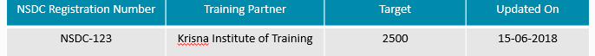
Lands on the Update Targets Page
Search updated targets using NSDC Reg. Number
Search
2
SCGJ Admin
Enters the NSDC Reg Number and the Updated Targets
1
Result Exists ?
Update targets
No Data Found
NO
Targets
Updated?
NSDC No
Exists?
YES
Targets updated successfully
YES
YES
NO
NO
Targets could not be updated
Training Partner does not exists

